Slide 1
Grid-based Navigation for
Mobile Robots
Lecture 2

Slide 2
Basic Methodology
Given an occupancy grid map construct its equivalent cost grid map.
From the starting position move along the direction of the most negative gradient and reach the next grid along that direction
Repeat the above step till goal is reached

Slide 3
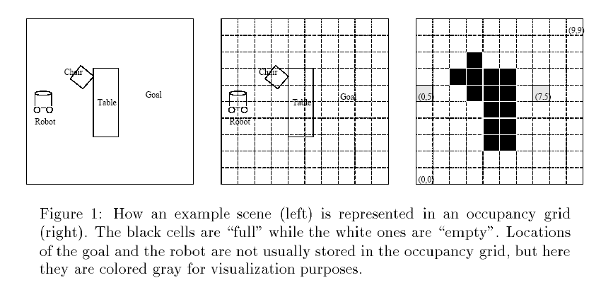
Constructing the cost-grid
Each cell in the cost grid denotes the distance from that location to the goal

Slide 4
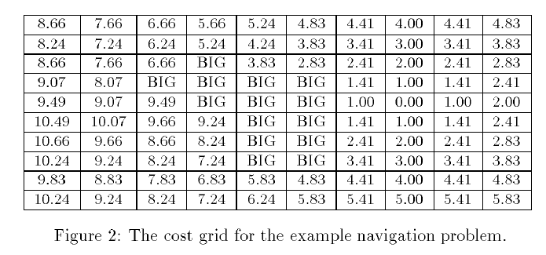
Constructing the cost-grid

Slide 5
Constructing the cost-grid (contd.)
Initially all cells (occupied and non occupied cells) excepting the goal cell are initialized to BIG values except the goal cell
A list “open” stores the cells whose values have been lowered from their initialized values. The list is sorted with the lowest values at the top of the list that are popped. (Initially the list contains only the goal node)
The top most node in the list is popped and expanded to its neighbors, whose values are in turn lowered and inserted to the sorted list at their respective places.
The process continues till all cells in the grid have been expanded once.

Slide 6
Constructing the cost-grid (contd.)
How the cell costs are lowered: The lower cost is computed by looking at neighboring cells and using an estimate of travel cost from the adjacent cells to the current cell. For laterally adjacent cells the estimate is 1 and for diagonally adjacent cells its 1.414. This estimate is added to the previously computed cost at the adjacent cell to give the cost at the current cell. The minimum of such costs becomes the cost at the current cell.

Slide 7
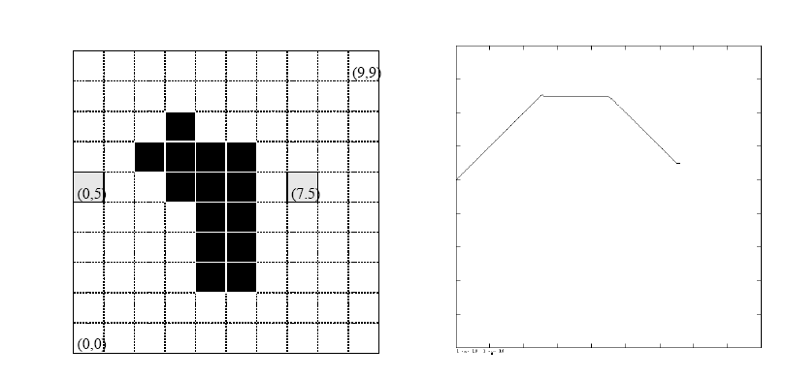
An Example Path:

